Slide 1
YouTube’s
Performance Predictor
SVNT TAP @ SAP
Kyle Tengco

Slide 2
Team Idea Overview

Slide 3
Using tags, view counts, and temporal data, our feature will help a YouTuber plan the topic of their next video.
Team Idea Overview

Slide 4
We ask our YouTuber to provide us with some tags for their next video...
Team Idea Overview

Slide 5
...in addition to an estimated publish date.
Team Idea Overview

Slide 6
With that information, we give them a performance prediction and content recommendations.
Team Idea Overview

Slide 7
My Contribution

Slide 8
Provide a thinking framework to understand what it is we’re building.
My Contribution

Slide 9
WHY am I building this?
WHO am I building for?
WHEN and WHERE will it be used?
WHAT am I building?
HOW could I measure it?
My Contribution

Slide 10
Defined a persona to remind us of who will actually be using this feature.
My Contribution

Slide 11
Advocated for the user to ensure that we were building a product a YouTuber might actually want to use.
My Contribution

Slide 12
Demo

Slide 13
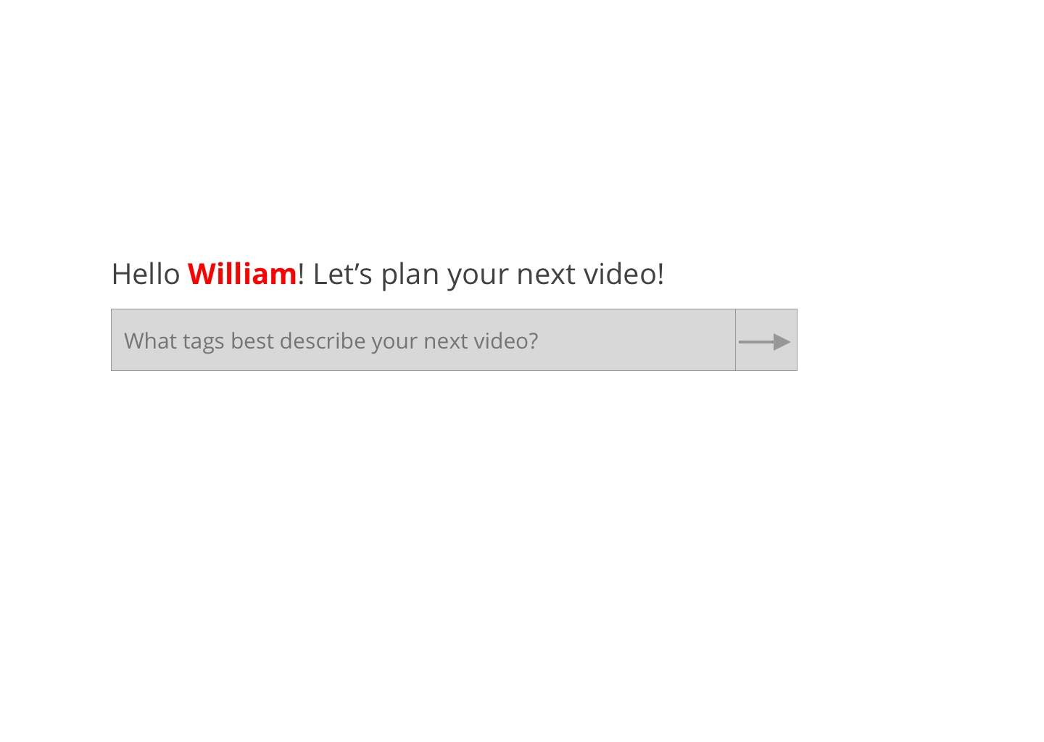
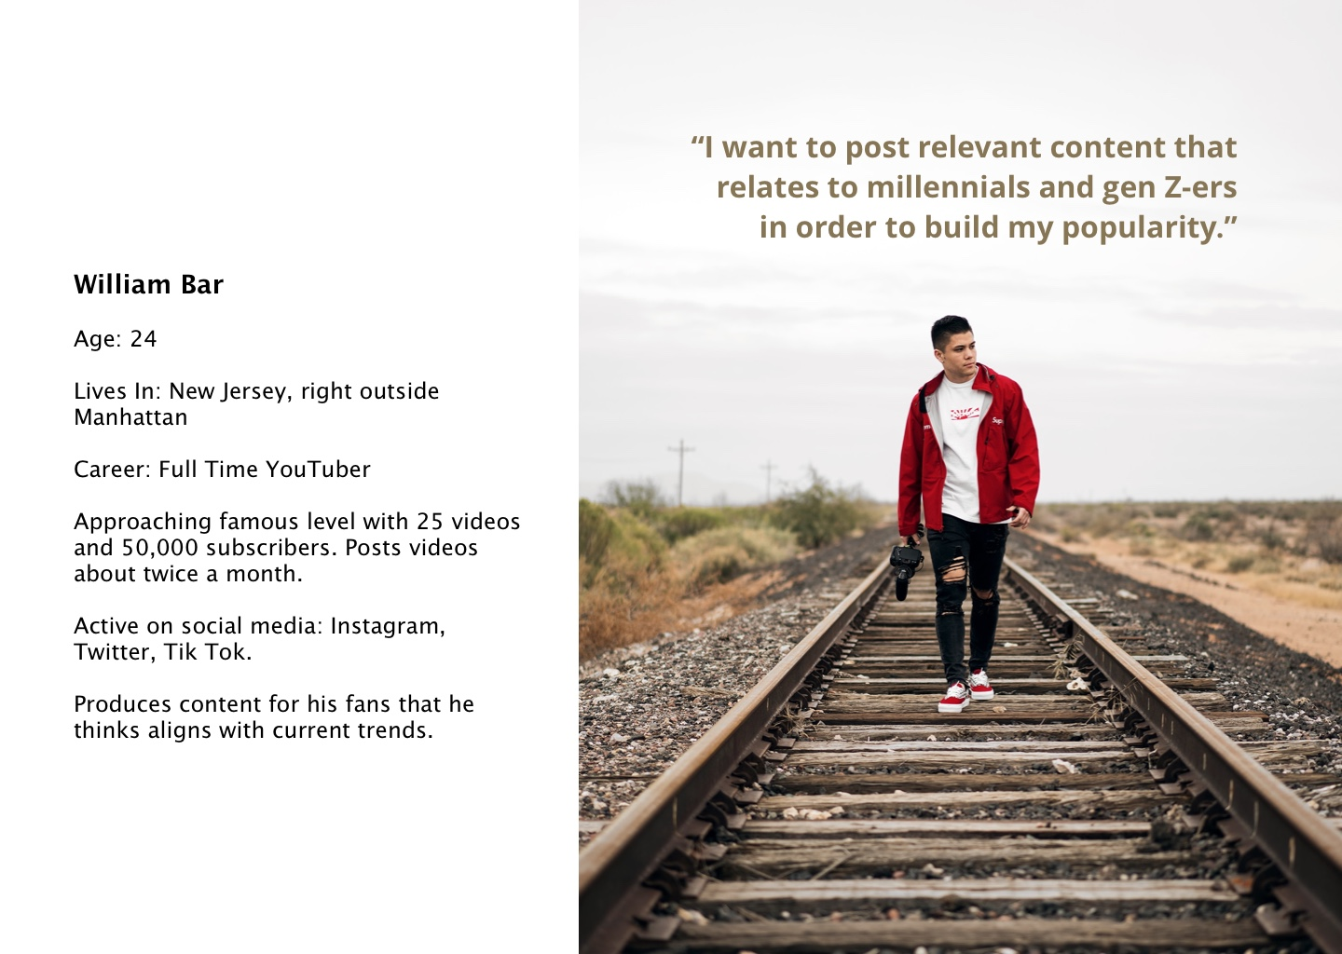

Slide 15
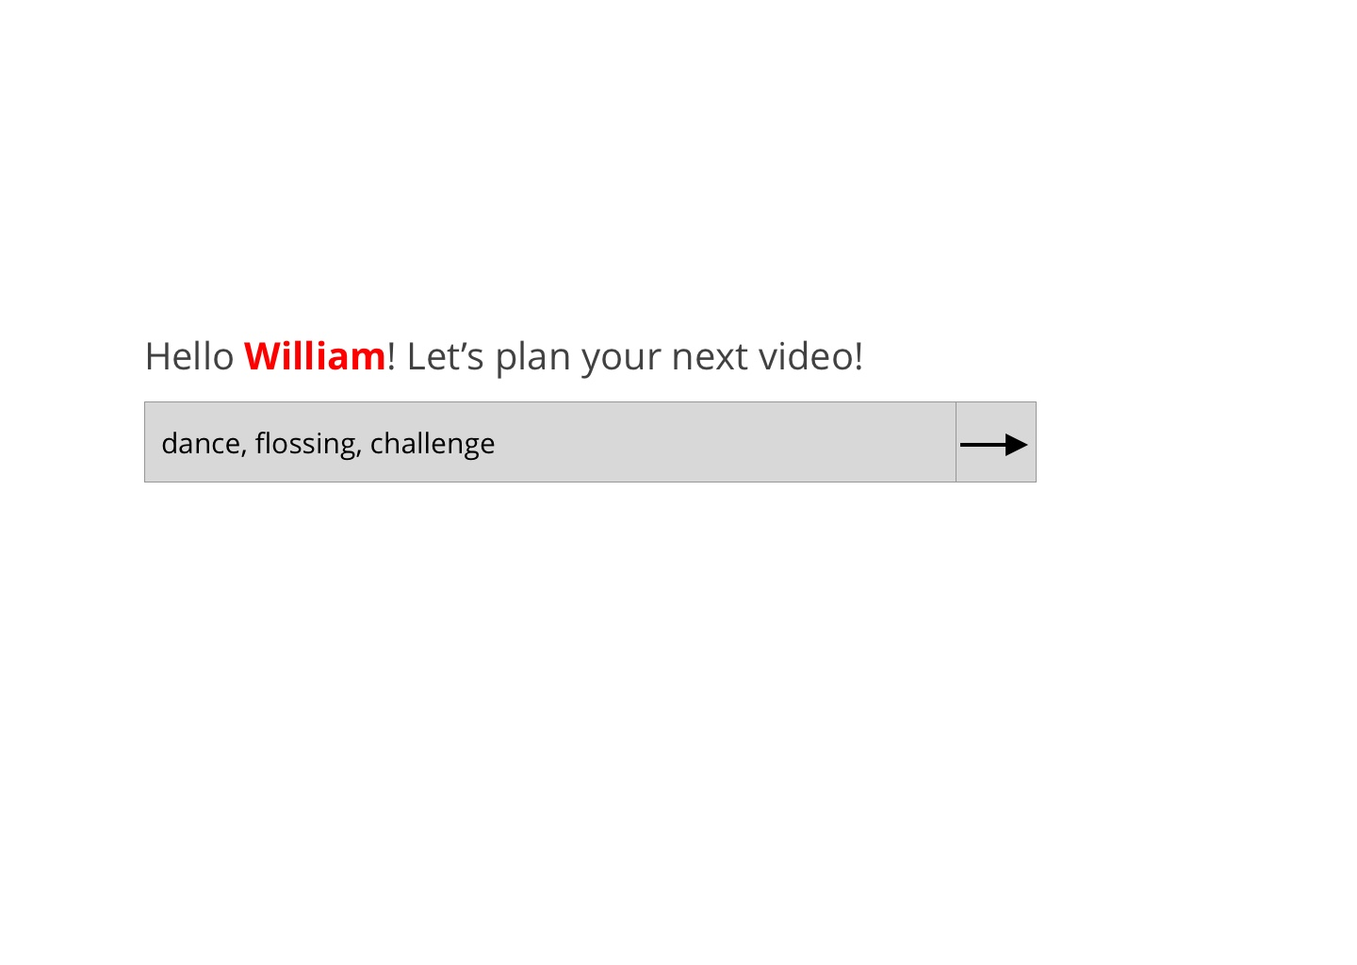

Slide 16
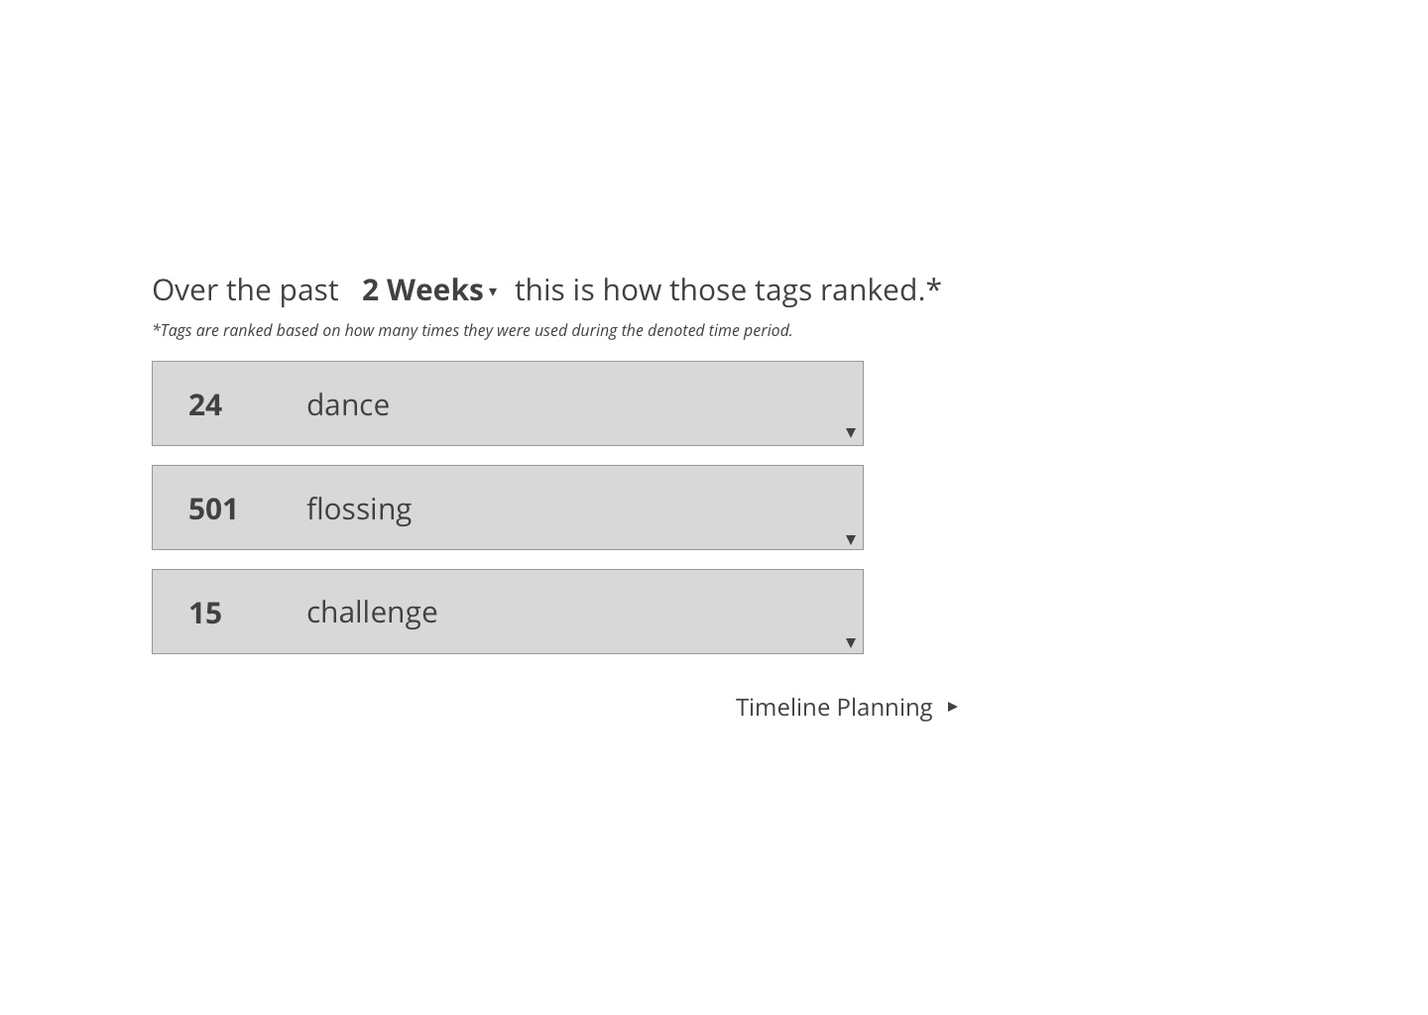

Slide 17
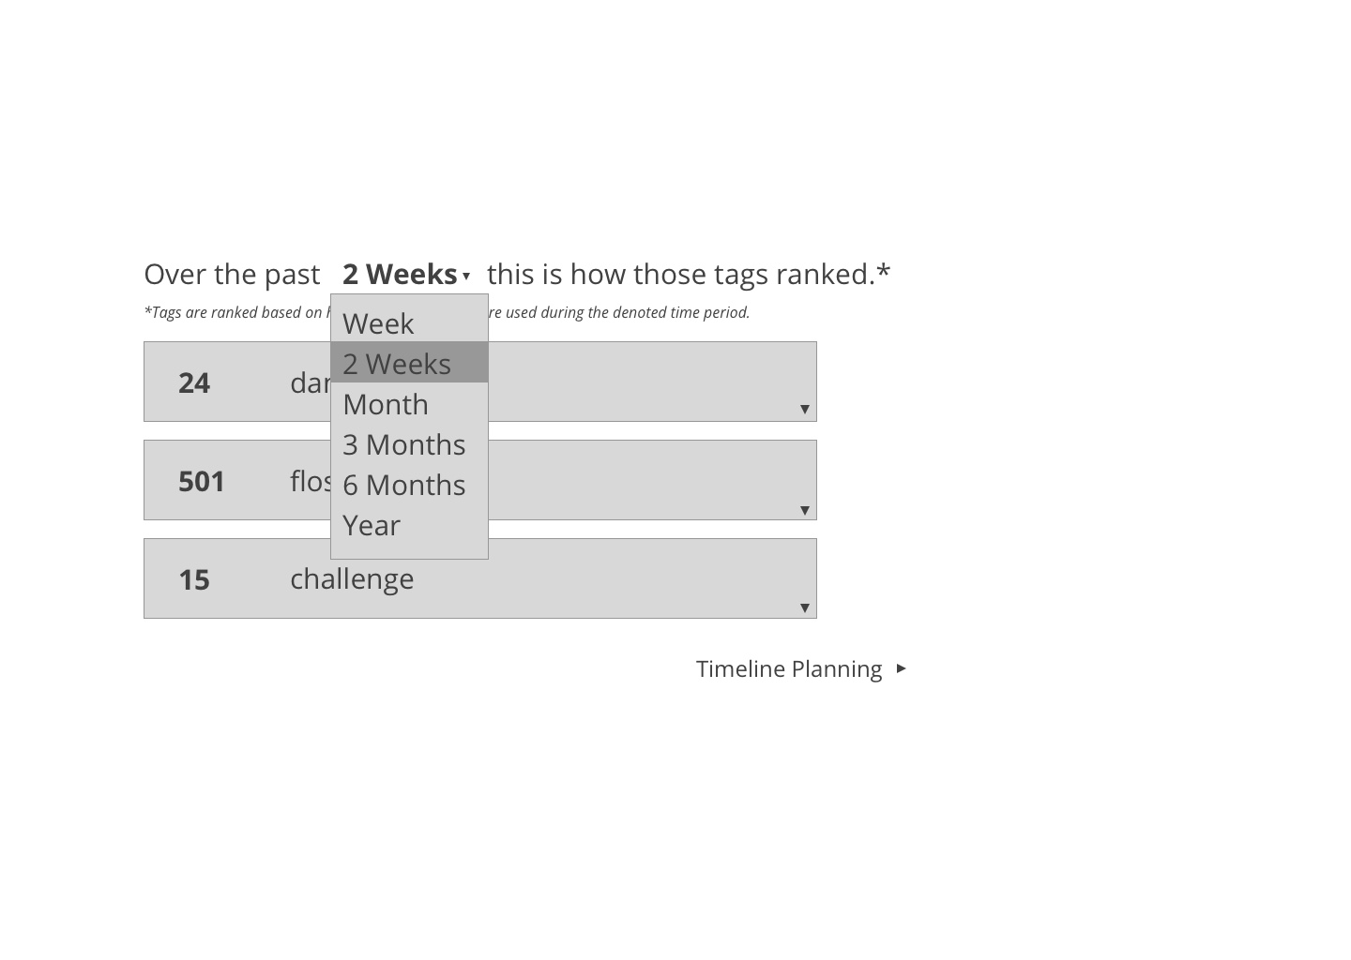

Slide 19
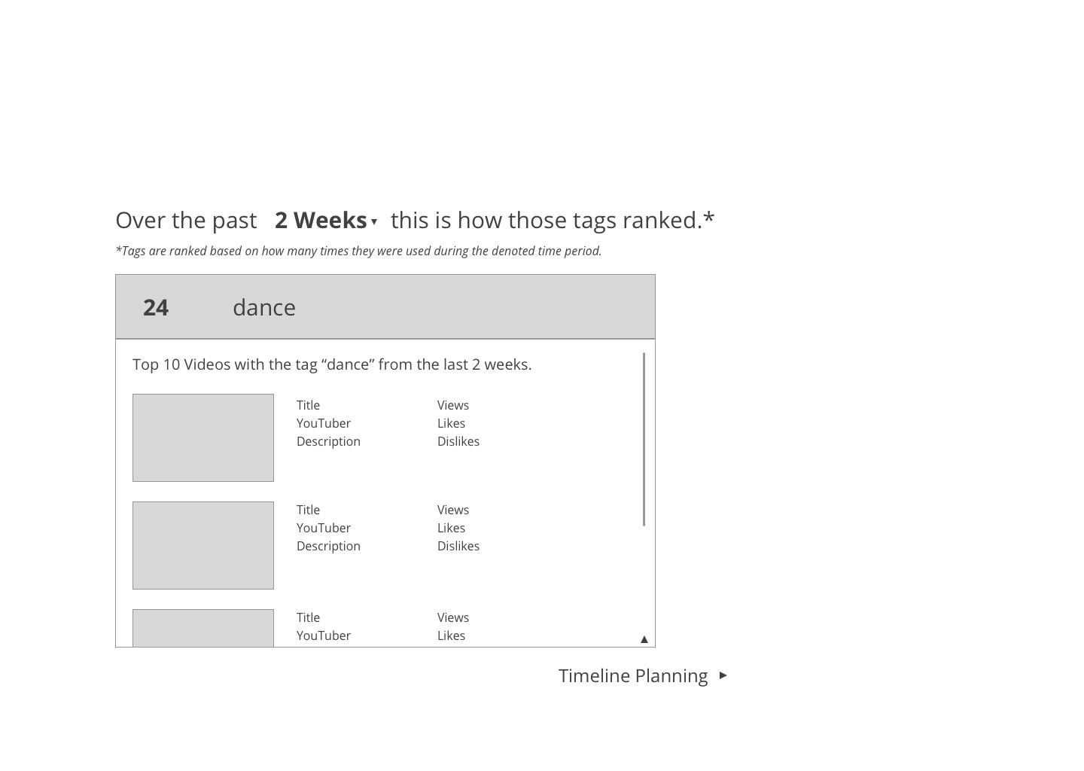

Slide 20
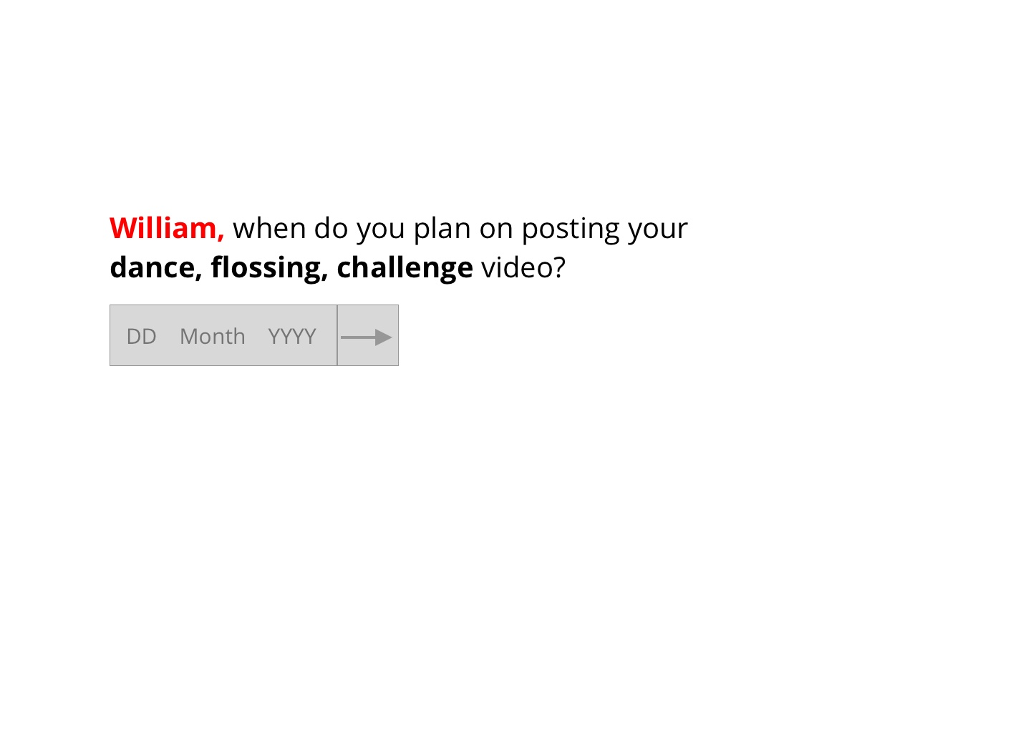

Slide 21
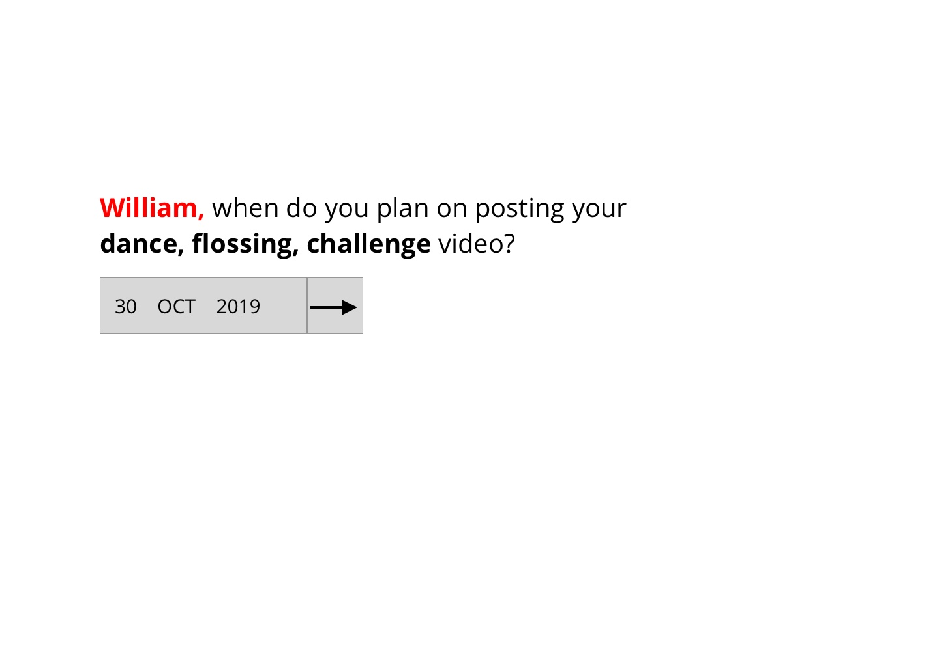

Slide 22
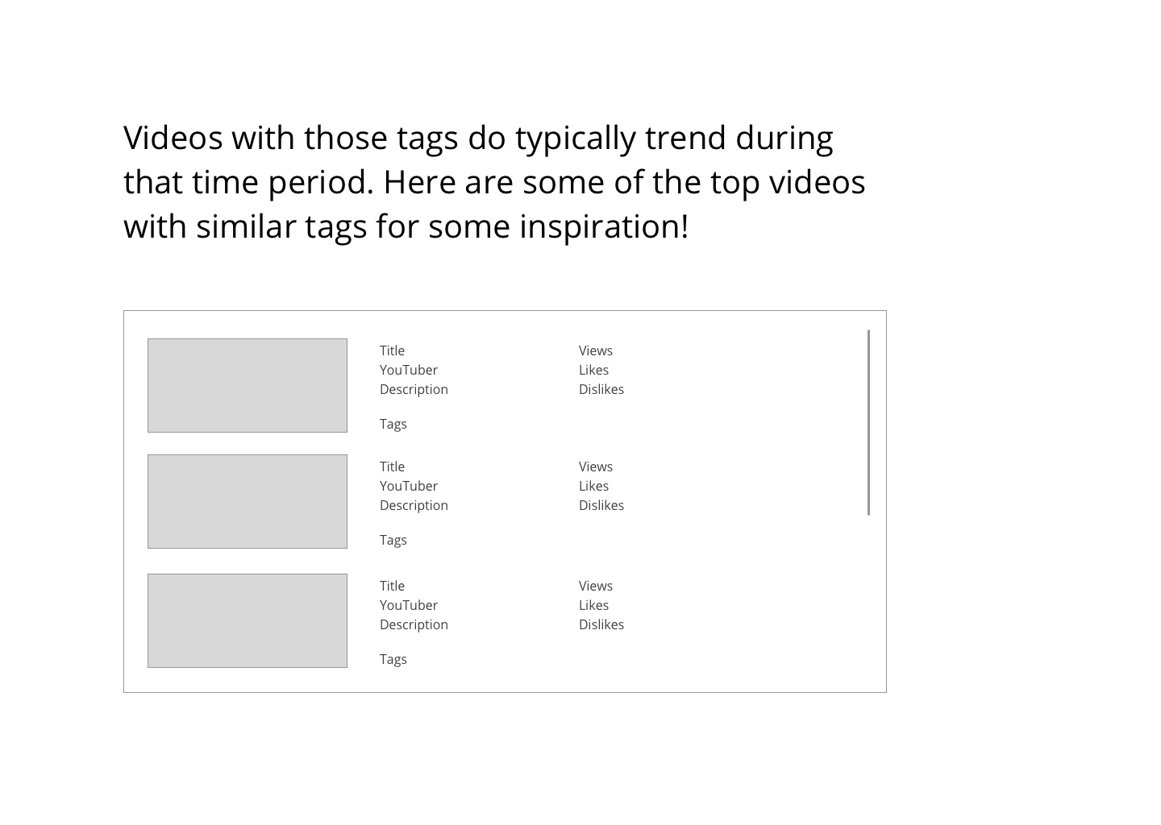

Slide 23
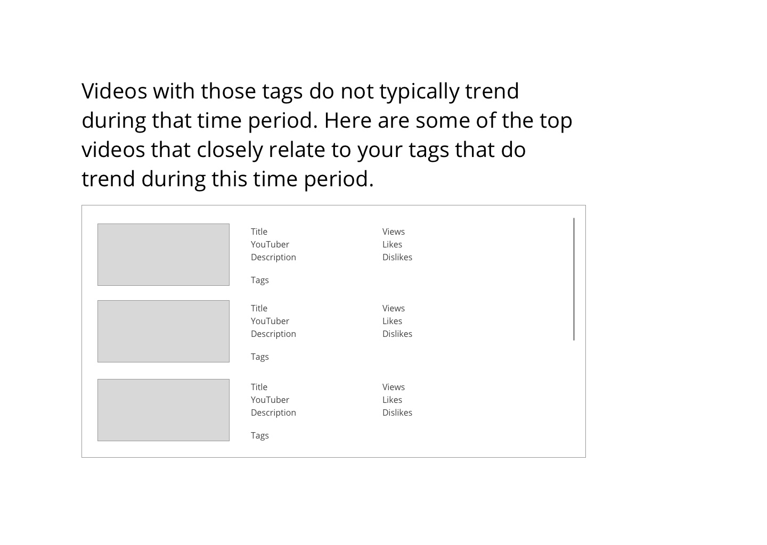

Slide 24
Future Considerations

Slide 25
Using a category filter to give the YouTuber a more accurate history of tag rankings.
Future Considerations
Notes:
Is our lack of constraint even enough to give accurate recommendations.

Slide 26
Consider what data the user actually sees.
Future Considerations
Notes:
Does this provide meaning for the end user?

Slide 27
Incorporating current events.
Future Considerations
Notes:
Does this provide meaning for the end user?

Slide 28
Thank You!

